Slide 1


A Model Driven Architecture Approach to Generating Health Information Exchange Implementations Leveraging the Federal Health Information Model (FHIM) and the NIEM Framework
Steven Wagner, FHA Standards Program Manager
Federal Health Architecture Office
Office of the National Coordinator for Health IT, DHHS
Twitter #NIEMNTE1

Slide 2
Agenda
Background on FHA Standards Program
Model Driven Architecture Approach
The logical model - Federal Health Information Model (FHIM)
Terminology models and value sets
Implementation modeling tools - Model Driven Health Tools (MDHT) and NIEM XML/XSDs
Prototypes - Lessons Learned, Issues Identified
Future work
Summary
Twitter #NIEMNTE1

Slide 3
Background
Twitter #NIEMNTE1

Slide 4
Information Modeling Project and FHIM Context
      Staffed by LC Members (guides FHIMS WG by setting
      priorities and developing/approving strategy)
Staffed by FHA Program Manager and potentially other
support resources (manages Federal Health Interoperability Modeling and Standards (FHIMS) WG and supports FHIMS Steering Group and all projects)
Staffed by part-time Federal partner resources (2-3 project leads and at least one contact/participant from each Federal partner
      Steering Group for FHIMS WG
      FHIMS WG
      IM Project
      (develops the FHIM)
Twitter #NIEMNTE1

Slide 5
Steering Group and Modeling Participants
Steering Group Members:
DoD SSA CDC VHA NCI CMS (being replaced)
Information Modeling Project comprised of volunteers from:
DoD/MHS | CDC
VA / VHA | SSA
DHHS | SAMHSA
CMS | IHS
FDA | NCI
NLM | FHA
All are encouraged to invite
Subject Matter Experts (SMEs)
from their respective organizations
to provide insight and input on
models, standards, and definitions.
Twitter #NIEMNTE1

Slide 6
Goal and Principles
Goal
  Produce a logical, health information model that supports semantic interoperability and that is built by harmonizing information from the individual Federal partners and standards organizations
Principles
  The model will be expressed in standard Unified Modeling Language (UML) notation (it may also be expressed in other notations)
  The model will be designed to meet all Federal partner semantic interoperability needs for the exchange of information with other organizations
  The model will support existing national health standards
  The model will be in the public domain, freely available and easy to access
  The model will be specified as a logical model consisting of a set of domain models
  The model will not specify behaviors (operations) and, at least initially, will not specify constraints or rules
  The model will be made available as an XMI export
Twitter #NIEMNTE1

Slide 7
Modeling Priorities and Participation
Modeling priorities for the FHIM are set by a Steering Group of six Federal partners
FHIM priorities include full support for information domains specified by the Clinical Care Document (CCD) and Meaningful Use
Eleven Federal partners are participating directly in the Information Modeling (IM) Project (VA, DoD, FDA, CDC, NCI, HHS, CMS, IHS, SSA, SAMHSA and NLM)
All other Federal partners have the opportunity to participate through model reviews/feedback (which have not yet occurred)
Twitter #NIEMNTE1

Slide 8
Model Driven Architecture
(MDA) Approach
Twitter #NIEMNTE1

Slide 9
Model Driven Architecture View Describing Relationship Between FHIM and NIEM
Business Models
(BPMN & BPEL)
Used to Generate
Used to Generate
Software Behavior Models
(UML)
Logical (Static) Information Models
(UML)
Used to Generate
FHIM
Used to Generate
Used to Generate
Used to Generate
Information Exchange (IEPD) Models
(XML Schemas)
Physical Databases
(Relational or Other DB)
NIEM
Used to Generate
Twitter #NIEMNTE1

Slide 10
Model Driven Architecture View Integration of FHIM, NIEM, HITSP and Health SDOs
Terminology Models and Value Set Definitions
(terminology server)
Federal Health Information Model (FHIM)
(meta data)
Provides
Information
To
UML Profile
Contribute
Data To
Provides
Information To
Contributes
Data To
Contribute
Data To
Contributes
Data To
Implementation Modeling Tools
Open Health Tools (OHT)
UML Tools (MDHT)
HITSP
Health SDOs
HL7 & Others
Contributes
Process To
NIEM
Contributes
Process To
Produces
Contributes
Process To
XML Implementation Std
IE Documentation
Certification Criteria
MDMI
Twitter #NIEMNTE1

Slide 11
MDA Approach Support for Model Abstractions
Supports the 3 Object Management Group/MDA model abstractions
  Computationally Independent Model (CIM)
  Platform Independent Model (PIM)
  Platform Specific Model (PSM)
    FHIM content is derived from CIMs
    The FHIM model is a PIM
    PSMs are produced by MDHT
CIM
PIM
PSM
Twitter #NIEMNTE1

Slide 12
Information Modeling Benefits
The models retain use case context
The models are integrated (2-way links between Information Terminology models)
The modeling process harmonizes content (information and terminology) across organizations
The models support efficient standards development
The models are being integrated with the MDHT to support a model-driven approach to development of information exchange interoperability specifications
The models can be leveraged by organizations for internal use in systems and database development
The models are developed using standard UML
Twitter #NIEMNTE1

Slide 13
The logical model - Federal Health Information Model (FHIM)
Twitter #NIEMNTE1

Slide 14
Information Modeling Approach
Initial baseline model created by drawing on existing UML models from VHA, NCI and FDA
HL7 Reference Information Model (RIM) used as a reference model for the FHIM
Developed using a standard process and style guide
  Lead FHIM modeler ensures consistency, integration and harmonization across domain models
  Health information divided into domains (e.g., Person, Laboratory, Medications/Pharmacy, etc.) - each domain has a modeling team
    Modeling team consists of lead modeler, SMEs, Federal partner liaisons, others
  Model each domain starting with existing information from baseline model
  Incorporate and harmonize information from Federal partners
  Incorporate and harmonize information from standards organizations
The FHIM is versioned and stored in a GForge repository as it is developed
The FHIM is distributed for review/feedback by Federal partners
Twitter #NIEMNTE1

Slide 15
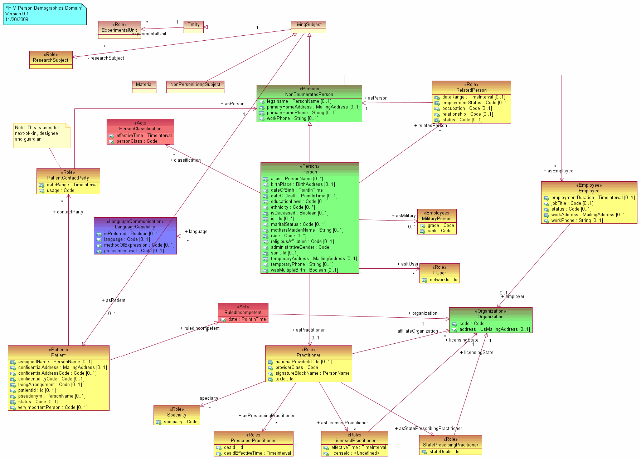
Information Modeling Process
Sept 2009
Nov 2009
Dec
2009
Jan 2010 … ongoing…
Define
Style
Guide/
Tools
Draft
Models /
Document
Concepts
& codes
Vet
Model &
Concepts
Generate
Interoperability
Specifications
Provide
Models, Specs,
Definitions to SDOs & Agencies
Define
Strategy
Define
Modeling
Process
Gather
Participants
Establish
Workgroups
Harmonize
Feedback
Repeats for each domain
Create a baseline model from existing VA, NCI and FDA models
Use the HL7 RIM as a reference model
Harmonize information across the FHA Federal Partners/Agencies
Harmonize with information defined by health SDOs and HITSP
Identify concepts and terminologies in need of harmonization
Fully document coded data attributes and their value sets
Vet model, terminologies/value sets and definitions with FHA Federal Partners/Agencies and harmonize final comments
Use model driven architecture approach to produce interoperability specifications
Integrate model approach and content into existing SDO development processes
IE Interoperability specifications available for FHA Partners/Agencies to leverage
Twitter #NIEMNTE1

Slide 16
Terminology models and value sets
Twitter #NIEMNTE1

Slide 17
Terminology Models and Value Sets
This is where the greatest amount of work remains to be accomplished
Terminology is critical to health interoperability and it is highly complex
Lots of work is underway - including an International Health Terminology Standards Development Organization (IHTSDO)
A standard called CTS2 has been developed to support implementation of terminology servers
Twitter #NIEMNTE1

Slide 18
The FHIM and Terminology Models and Value Sets
FHIM links to terminology models/value sets by storing a unique value set ID
Terminology models maintain all other terminology information
FHIM maintains traceability to use cases and the Health Level 7 (HL7) EHR-System Functional Model
FHIM incorporates information from Computationally Independent Models (CIMs)
FHIM is a Platform Independent Model (PIM)
Twitter #NIEMNTE1

Slide 19
Implementation modeling tools - Model Driven Health Tools (MDHT) and NIEM XML/XSDs
Twitter #NIEMNTE1

Slide 20
Overview of Model-Driven Health Tools
Open source project within Open Health Tools (OHT)
Based on Eclipse Platform - template driven and extensible
First tooling release in Jan 2011 targeting full-lifecycle support for CDA
  UML design of implementation guides
  Publishing ballot specs and developer docs
  Generating validation and Java runtime support
Prototype started using FHIM and NIEM core models and MDHT tooling to generate NIEM compliant XSD implementation
Can generate multiple implementation (PSM) models
MDHT provides tools to support 3 user groups - standards organizations, business analysts and Java implementers
19
Twitter #NIEMNTE1

Slide 21
Integration Activities with the National Information Exchange Model (NIEM)
Produced white paper analyzing integration of FHIM with NIEM
Analyzing the NIEM Core data elements for integration with the FHIM
Produced prototype that integrates the FHIM with the MDHT to generate a NIEM compliant information exchange implementation
Able to integrate with and support the NIEM process as adopted by the Standards and Interoperability (S&I) Framework
Twitter #NIEMNTE1

Slide 22
Prototypes - Lessons Learned, Issues Identified
Twitter #NIEMNTE1

Slide 23

FHIM Model Driven Prototype
Approach
1
FHIM Model
(PIM)
NIEM Health Domain
Harmonized
Uses
Lab Domain Integration Use Case
Constrains
2
Platform Independent
Uses
Lab Domain Exchange (PIM)
4
5
Platform Specific
MDHT
Transform
CDA Exchange PSM (UML)
NIEM Exchange PSM (UML)
8
Generate
Transform
Transform
Generate
9
6
7
CDA Implementation Guide Document
CDA Exchange Implementation
(Java)
NIEM Exchange PSM Implementation
(XSDs)
NIEM IEPD
Document

Slide 24
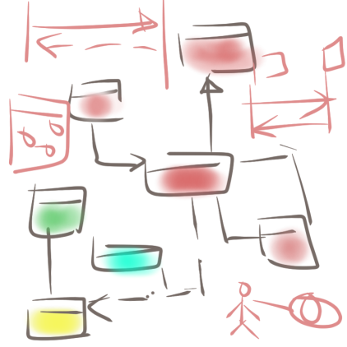
Prototype Step - 1
FHIM.emx
HITSP IS01
1
FHIM.emx
3
Use Case
Information
Requirements
Semantic Model Metadata
2
Harmonized
HITSP C35. C36, C37, C83
Value Set Binding
Coded Concept
HITSP C80/35
Terminology Model
Standard Coding System
Standard Coding System
Standard Coding System
Standard Coding System
Twitter #NIEMNTE1

Slide 25
Prototype Step - 2
CDA HITSP C37
FHIM.emx
Constraints
4
Header
Clinical Document
*
*
*
Section
*
Entry
Choice
Act
5
Encounter
Constraints
NIEM
Observation
Extensions
References
Extension
Media
Organizer
Procedure
Use Case
Region of
Interest
Terminology Model
IEPD
Substance
Administration
RSA 8.02 + MDHT Tools
constraints
<template>
LabResult
Supply
Twitter #NIEMNTE1

Slide 26
MDA: PIM-to-PSM and Testing Approach
Information
Requirements
Use Case
Terminology Model
PIM
PSM
CDA JAVA API
NIEM XSD
NCPDP SCRIPT XSD
HL7 V3 XSD
HL7 V2 XML Profiles
Other Examples
Test Cases
Reference Implementation
Reference Implementation
Reference Implementation
Reference Implementation
Test Cases
Test Case
Validation/Test Harness
Twitter #NIEMNTE1

Slide 27
Lessons Learned
Information Exchange Requirements - we learned that it is not feasible to reverse engineer requirements from implementation guides
Constraints - fall into three categories
  Constraints on the structure (e.g. cardinality, required/mandatory ) including extensions
  Vocabulary constraints specified as value set bindings
  Fixed/default values
Model-to-Model Transformation - Before a NIEM representation can be generated, new classes have to be added to the FHIM to create a NEIM Healthcare domain
Tooling Considerations - Another UML profile is envisioned to enable the transformation of FHIM content into specific standard constraints.
Twitter #NIEMNTE1

Slide 28
Lessons Learned
Referencing a Terminology Model
  A terminology model is required to specify the metadata for value sets and bindings including coded concepts and definitions
  A value set can be either explicitly enumerated (a static binding) or the code system can simply identify the values that can change over time (dynamic binding)
Transitional approach to adopting standard-based terminology
  A terminology service is needed to fully support terminology bindings
  In the short term, static value set bindings and open-ended dynamic bindings can be used to achieve a level of interoperability
Twitter #NIEMNTE1

Slide 29
Future work
Twitter #NIEMNTE1

Slide 30
Issues Identified During Prototype
General purpose terminology binding tools are needed that can be used regardless of standard.
Better support is needed for model-to-model transformation between PIM and PSM as seen in Figure 2 and Figure 3. One or more UML profiles and User Interface enhancements could provide the information required to ensure that the constraints in FHIM are applied to the appropriate standard construct.
A tooling roadmap that expands the current focus from CDA centric solutions to support other constraint-based standards and implementations such as NIEM, HL7 V2 or NCPDP.
Better support for document generation including use case descriptions, interactions and other substantiating analysis.
Twitter #NIEMNTE1

Slide 31












S&I Framework
Standards Development
Pilot Demonstration Projects
Use Case Development
and Functional Requirements
Harmonization of
Core Concepts (NIEM framework)
Implementation Specifications
Reference Implementation
Certification
and Testing
Scenario
Planning
NIEM IEPD Lifecycle
Create a NIEM Health standards harmonization process and governance framework
Establish roadmap for existing NHIN standards, MU harmonization, and non-MU health information exchange specifications
Establishes a repeatable, iterative process for developing widely reusable, computable implementation specifications
Establishing the tooling and repositories needed
Establishing the practices and guidelines for modeling
Enables semantic traceability so that useable code can be traced back to original requirements and definitions
Promotes transparency and collaboration from broad range of health stakeholders
Twitter #NIEMNTE1

Slide 32
Mapping of IM Project Models/MDHT Tools to S&I and NIEM Framework
IM Project Models and MDHT Tools
Information and Terminology Modeling
Implementation Modeling
Implementation Modeling
Standards Development
Pilot Demonstration Projects
Use Case Development
and Functional Requirements
Harmonization of
Core Concepts (NIEM framework)
Implementation Specifications
Reference Implementation
Certification
and Testing
Scenario
Planning
NIEM IEPD Lifecycle
Twitter #NIEMNTE1

Slide 33
How the Models/Tools of the IM Project Support the S&I Framework
Direct engagement of the Federal partner community
Support for Federal partner priorities such as VLER and MU
Direct support of Federal partner use cases
Adoptable by all organizations - models and tools are freely available
Traceability to the use cases and functional requirements supported
Provides semantic and syntactic modeling constructs to support the definition of information
Harmonizes standards across the Federal partners and standards organizations
Twitter #NIEMNTE1

Slide 34
Current Status of Information Domain Modeling
Domains Already Modeled (Total # of information domains to model approximately 50-60)
  Person
  Security and Privacy
  Eligibility, Enrollment, Coordination of Benefits
  Behavioral Health Assessments
  Problem
  Allergies
Currently Being Modeled
  Lab
  Medications/Pharmacy (including immunizations)
  Orders (General)
Domains Scheduled to Be Modeled
  Vital Signs
  Encounters
Twitter #NIEMNTE1

Slide 35
Summary
Freely available harmonized information and terminology models
Integrated with open source model-driven health tools
That can support multiple implementation platforms (PSMs), including NIEM
And that support the goals and requirements of the S&I Framework
Twitter #NIEMNTE1

Slide 36
Questions?
Twitter #NIEMNTE1

